Slide 1
LAB443 Hands on with Windows 11 & Cloud Native management
Harjit Dhaliwal and Ken Goossens

Slide 2


Meet the team
Harjit Dhaliwal
Sr. Product Marketing Manager
@Hoorge
Community Rockstar
Ken Goossens
Sr Product Manager
@Goosken
Just a random guy, talking Windows Stuff

Slide 3
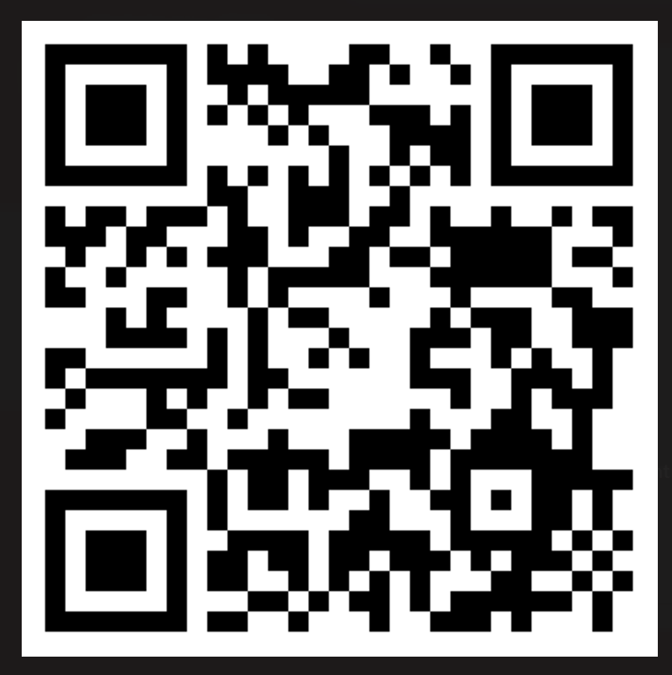
Download this deck from Github
https://aka.ms/Ignite2024Lab443

Slide 4
Module 1: Configure basics for Cloud Native Management

Slide 5
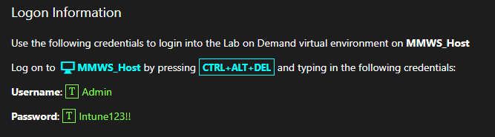
Logon Information

Slide 6

Lab 1: Prepare for Cloud Native Management
Exercise 1: Create additional administrative user account
Exercise 2: Deploy Windows licenses
Exercise 3: Configure automatic MDM registration
Exercise 4: Disable Windows Hello for Business
Exercise 5: Prepare branding for the Company Portal
Exercise 6: Prepare company branding for Windows Autopilot
Exercise 7: Add additional users to the local "Administrators"
Exercise 8: Configure enrollment notifications

Slide 7
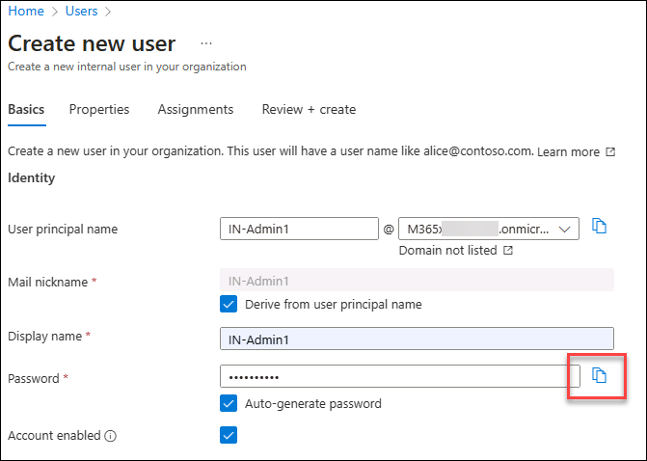
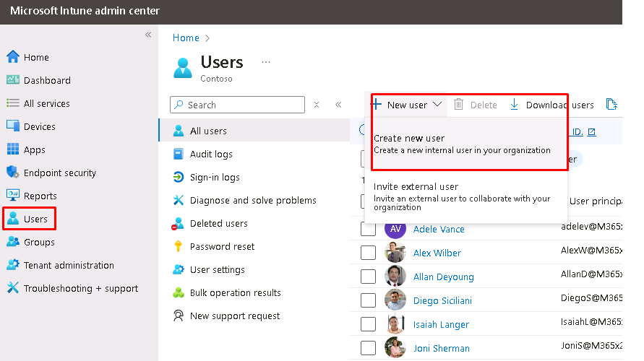
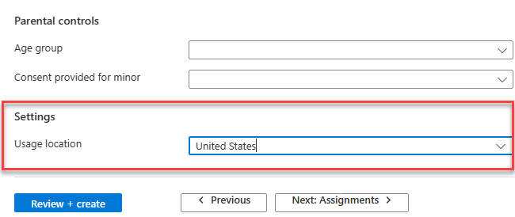
Exercise 1: Create Administrative user IN-Admin1
https://intune.microsoft.com
New user
Basics
Properties

Slide 8
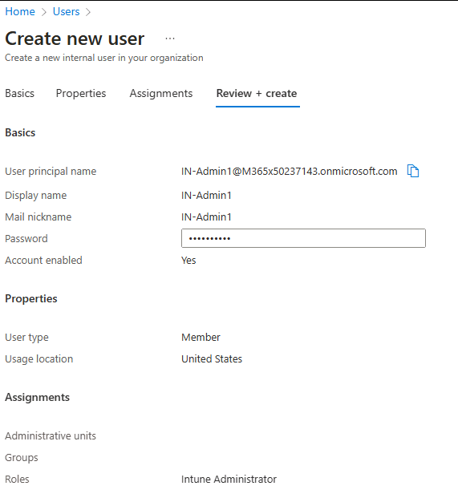
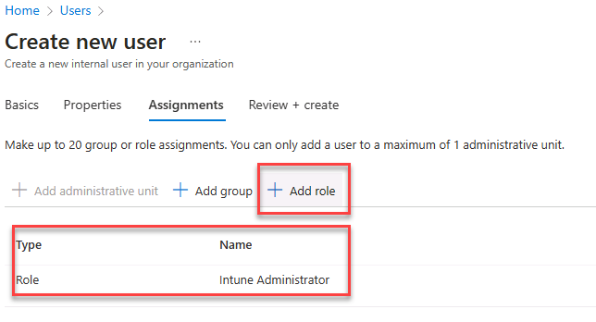
Exercise 1: Create Administrative user IN-Admin1
Assignments
Review + create

Slide 9
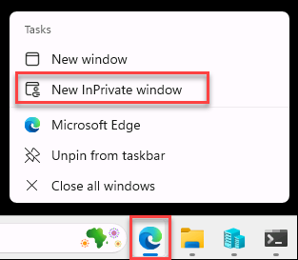
Exercise 1: Change the password for IN-Admin1

Slide 10
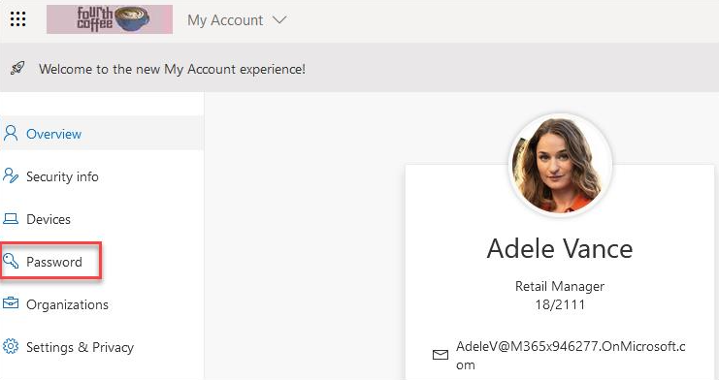
Exercise 1: Select a user for the labs and change the password for easier use.

Slide 11
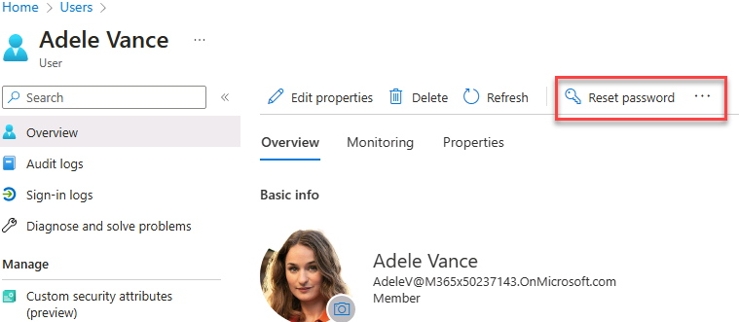
Exercise 1: What if the initial password does not work?

Slide 12
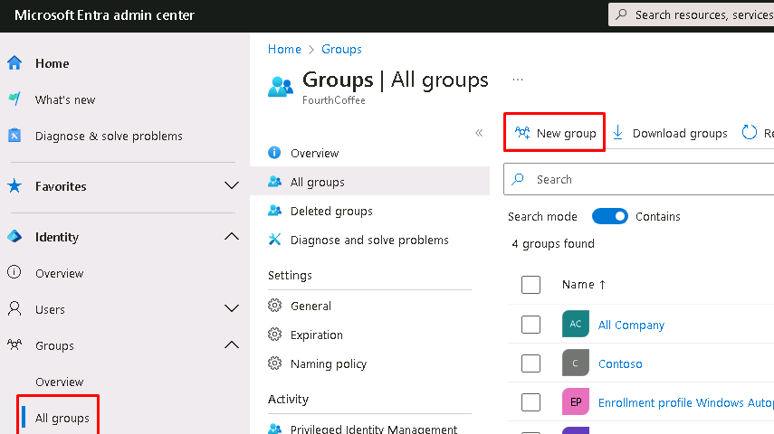
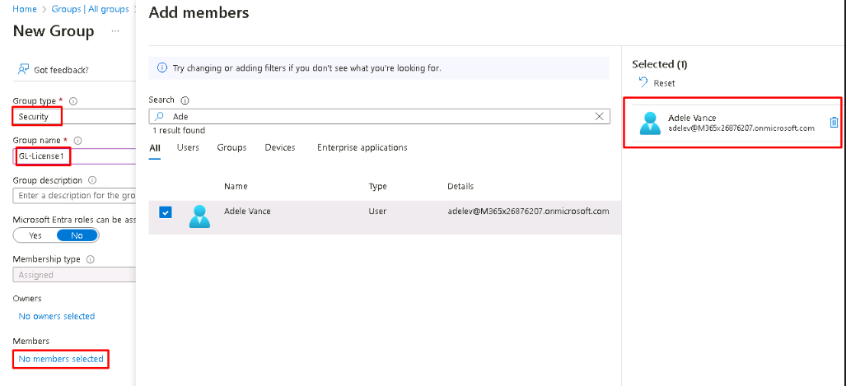
Exercise 2: Create Group GL-License1
https://entra.microsoft.com
New Group – GL-License1
Add Member

Slide 13
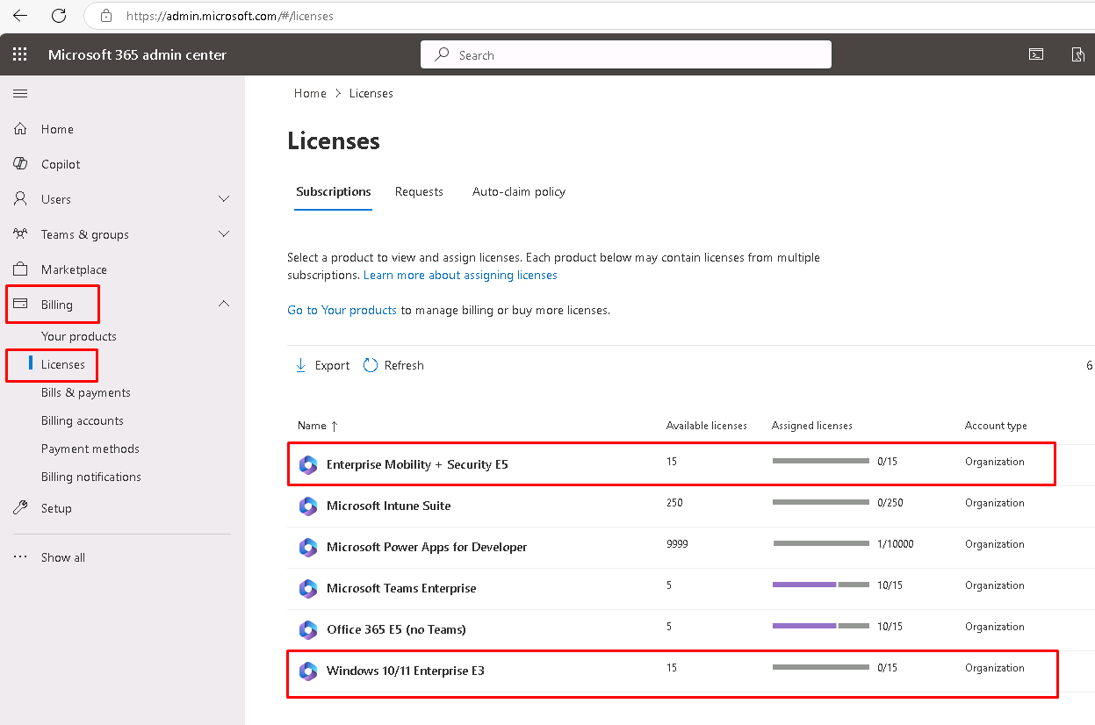
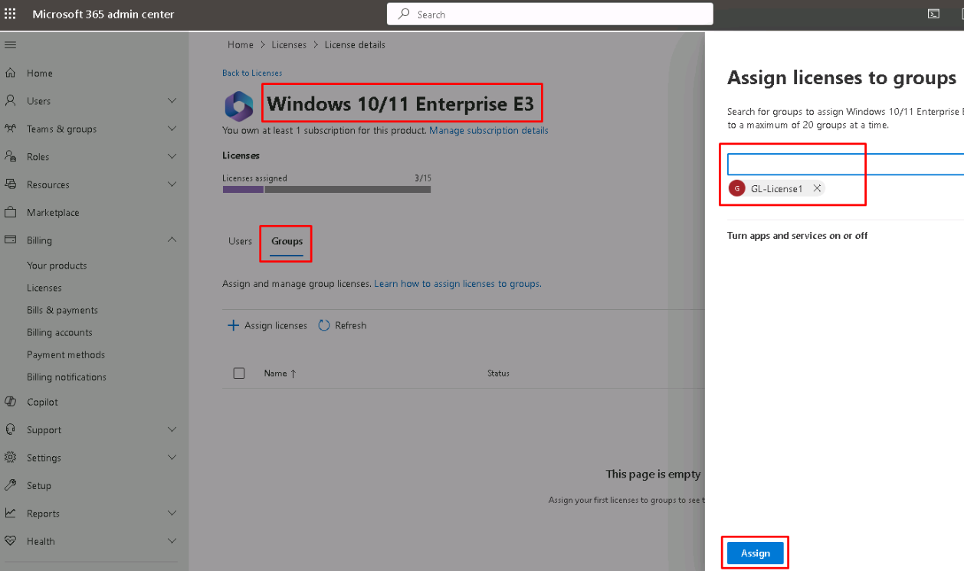
Exercise 2: Assign Group GL-License1 to the required Licenses
https://admin.microsoft.com
Click on the license
In Groups Assign the license

Slide 14
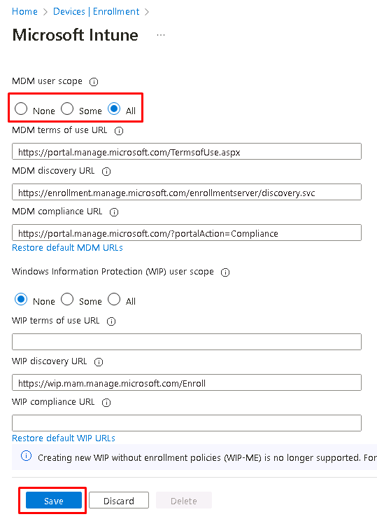
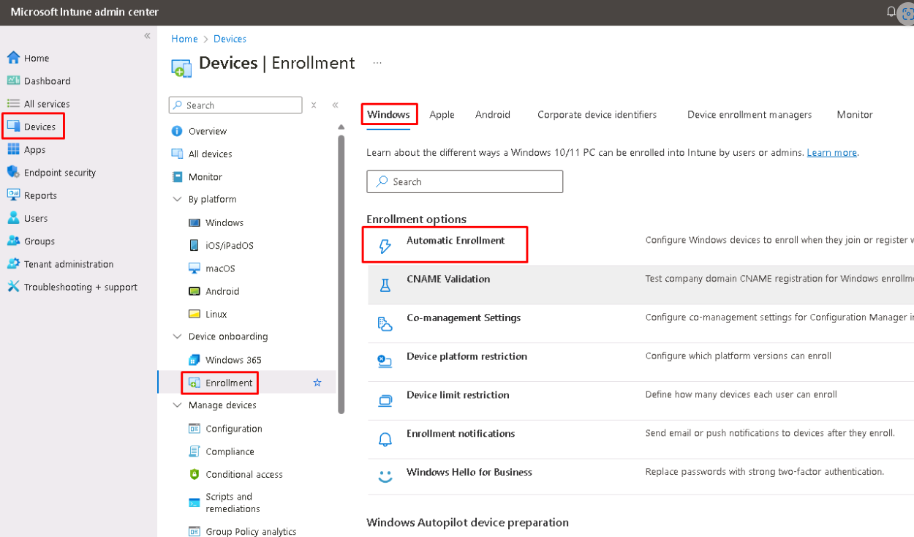
Exercise 3: Configure Automatic MDM registration
https://intune.microsoft.com
Automatic Enrollment
Select All

Slide 15
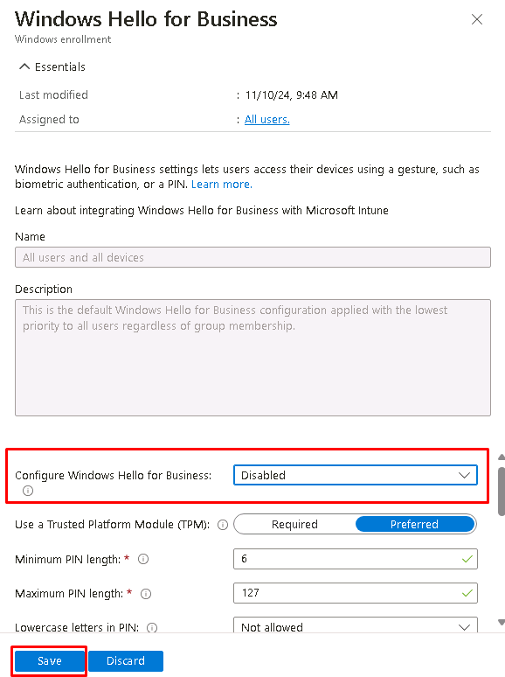
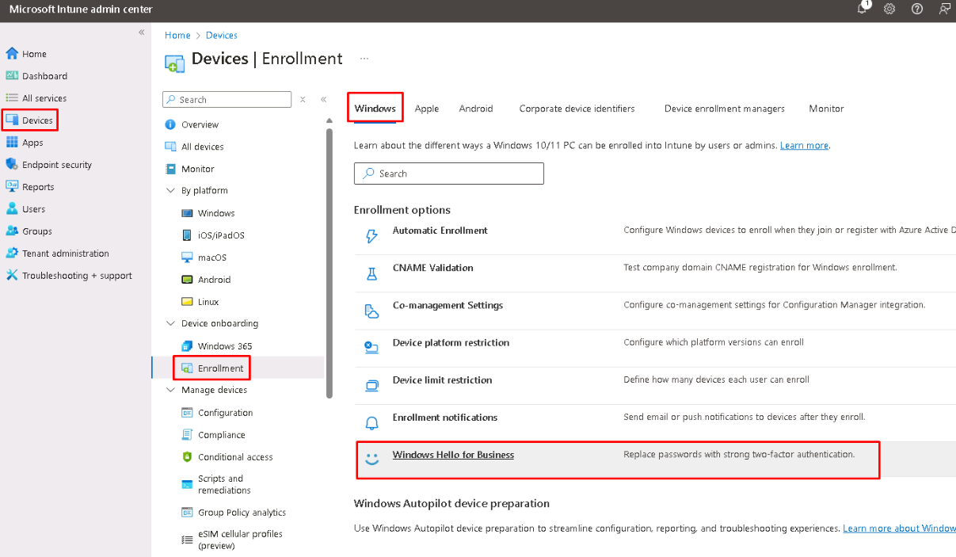
Exercise 4: Disable Windows Hello for Business
https://intune.microsoft.com
Windows Hello for Business
Disabled

Slide 16
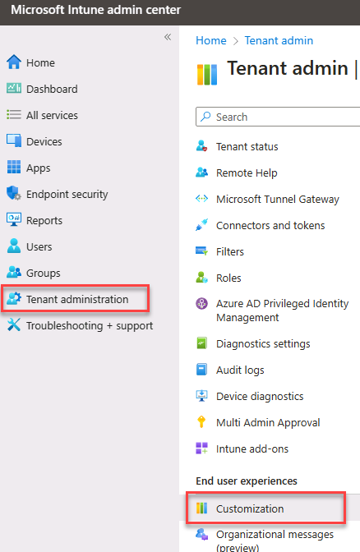
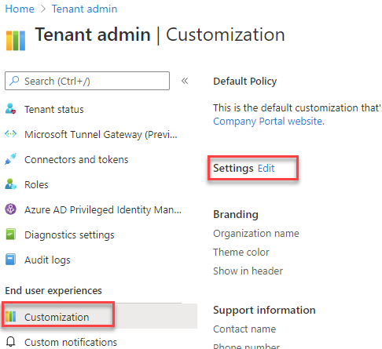
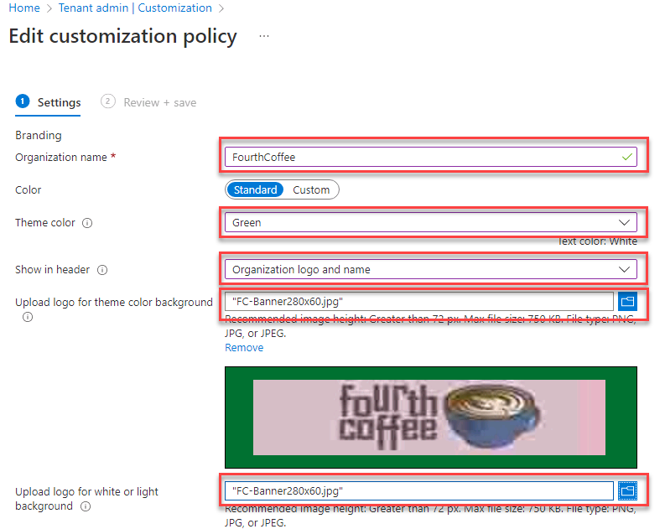
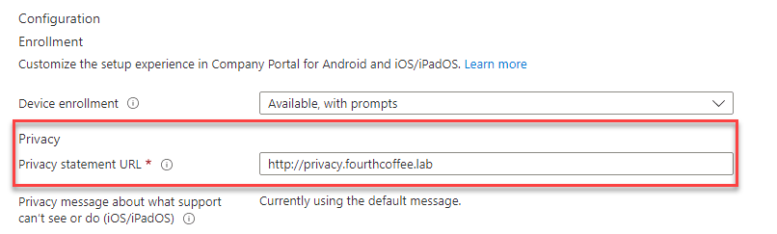
Exercise 5: Prepare branding for the Company Portal
https://intune.microsoft.com
Customization
Edit Settings
Settings
https://privacy.fourthcoffee.lab

Slide 17
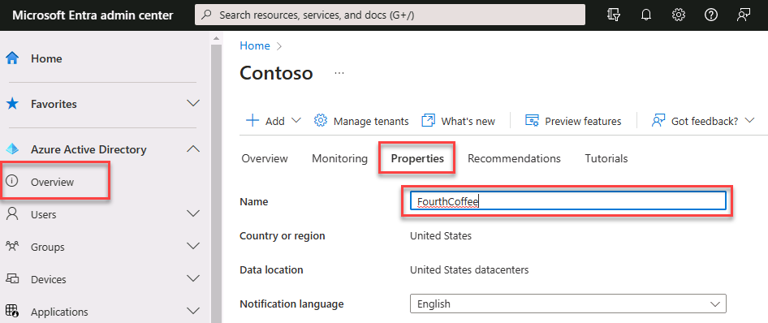
Exercise 6: Configure the company name in Entra
https://entra.microsoft.com

Slide 18
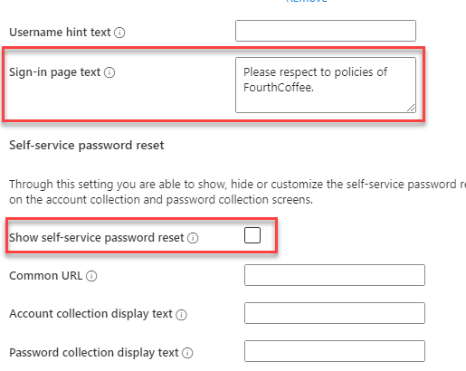
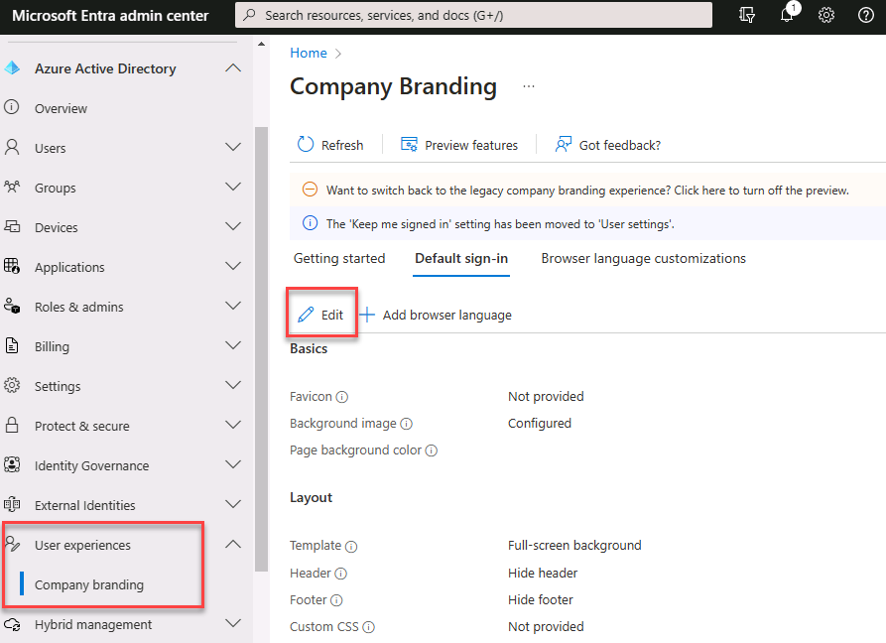
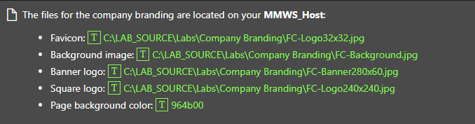
Exercise 6: Configure the company branding for Autopilot
https://entra.microsoft.com

Slide 19
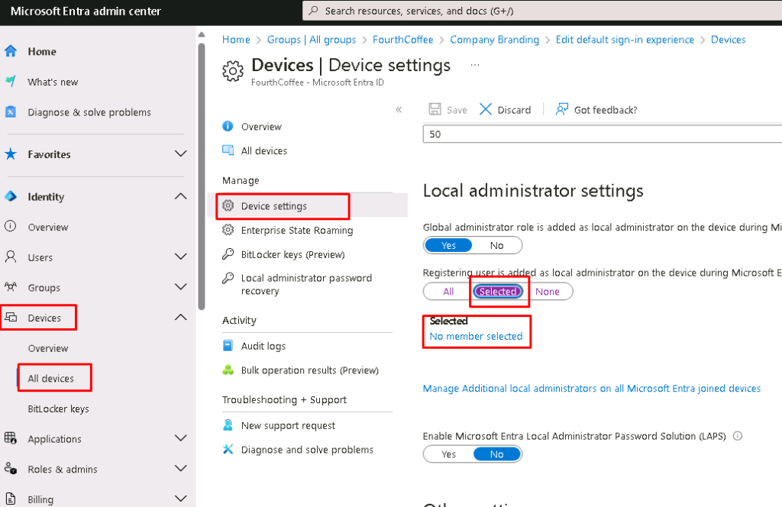
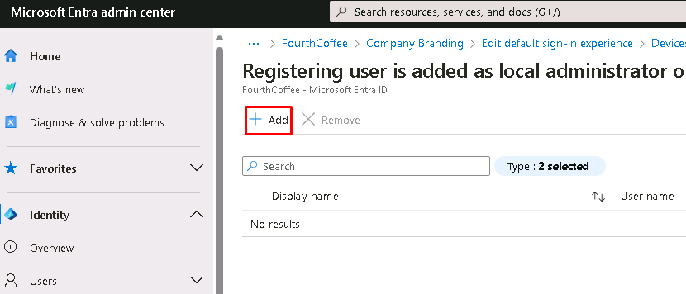
Exercise 7: Add IN-Admin1 to the local administrator group
https://entra.microsoft.com
Device Settings
Add In-Admin1

Slide 20
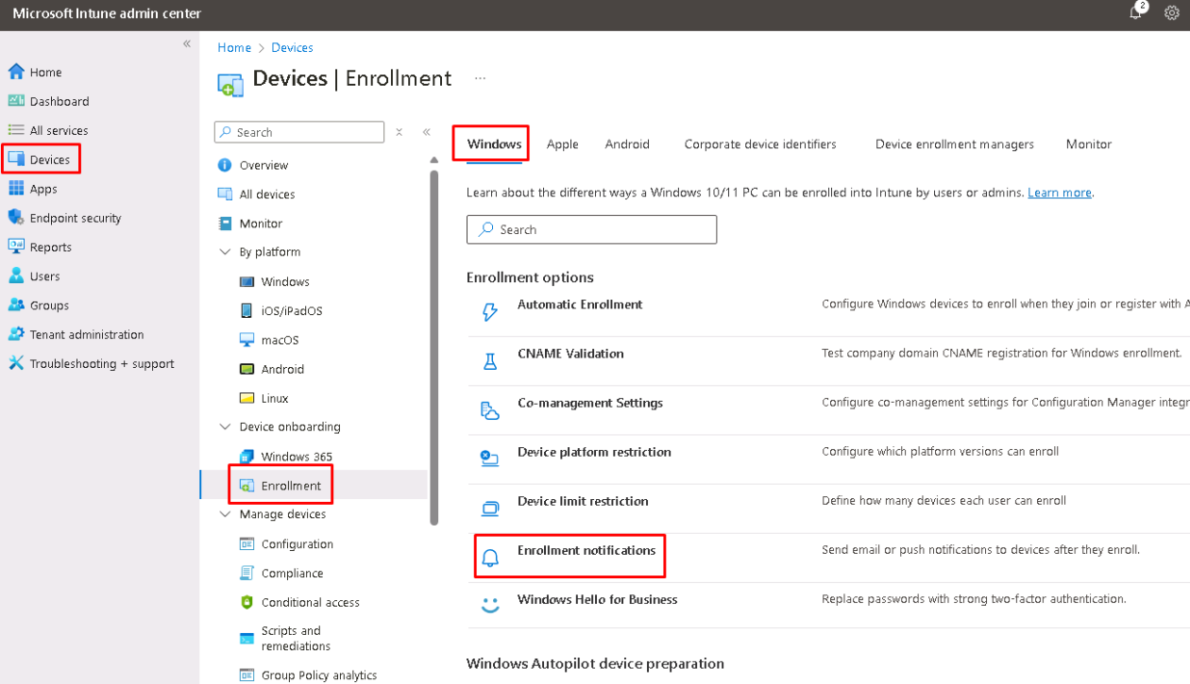
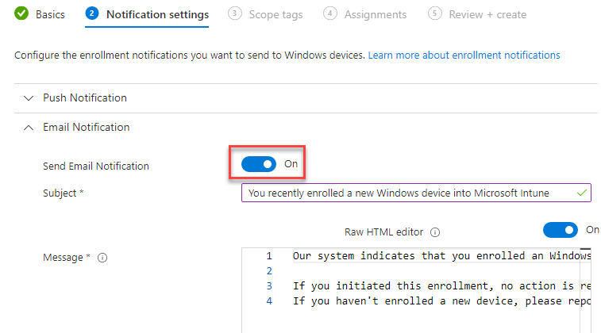
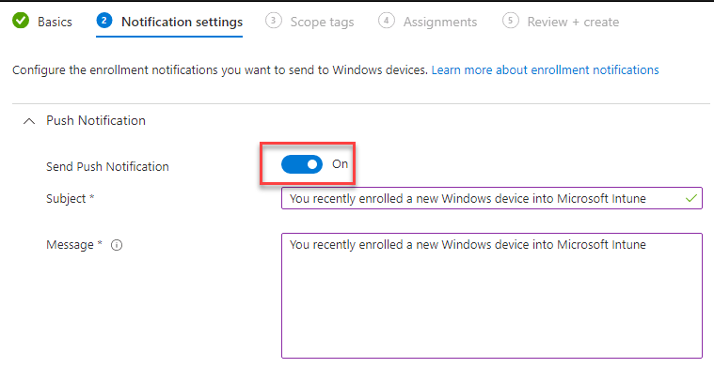
Exercise 8: Create an Enrollment notification
https://intune.microsoft.com
Enrollment Notifications
Send Push Notifications
Send Email Notifications
Scroll further down and enable all available options for email header, email footer, company name, contact information, and company portal website and assign to All Users

Slide 21
Module 2: Windows Autopilot Setup

Slide 22
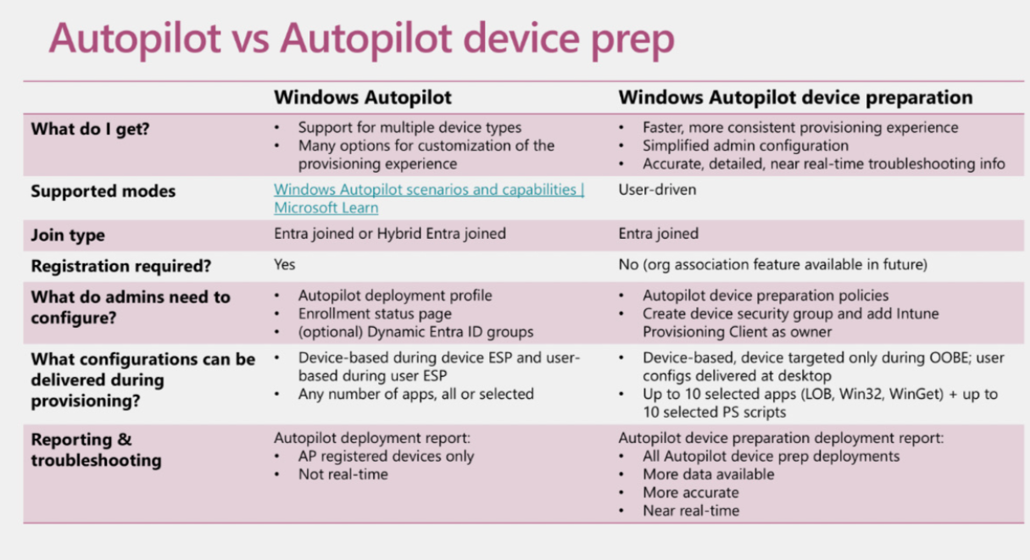

Slide 23

Lab 1: Get Ready for Autopilot
Exercise 1: Create a Deployment Group
Exercise 2: Configure Microsoft Intune Device Enrollment
Exercise 3 Configure an Enrollment Status Page
Exercise 4: Gather Hardware Information from a device
Exercise 5: Import device for Windows Autopilot
Exercise 6: Experience Windows Autopilot

Slide 24
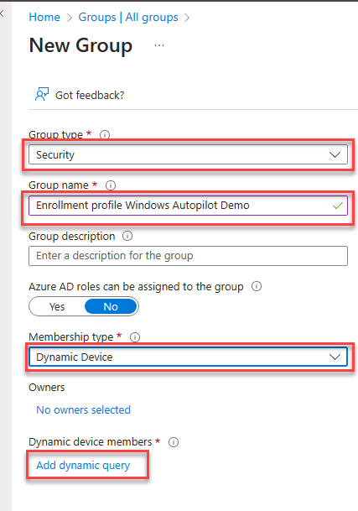
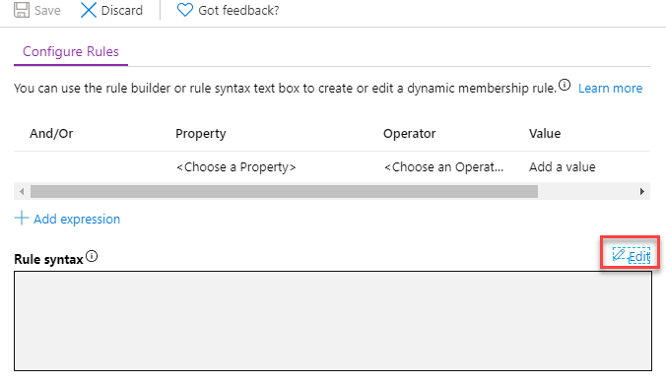
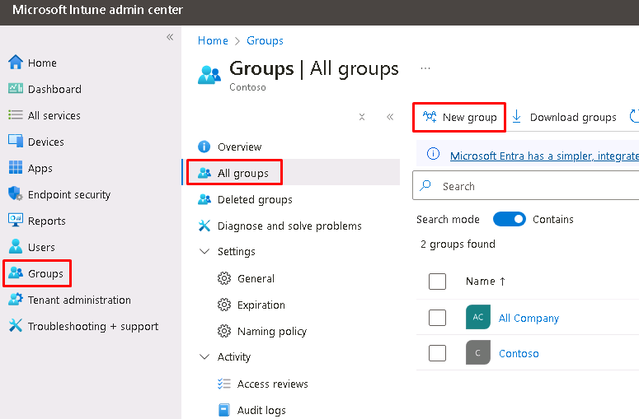
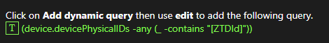
Exercise 1: Create a Deployment Group
https://intune.microsoft.com

Slide 25
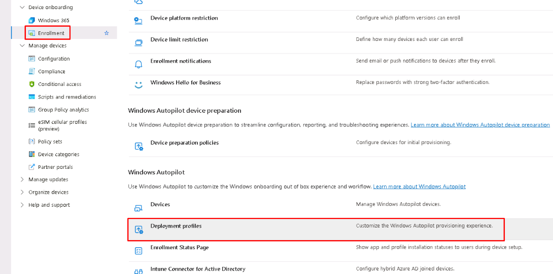
Exercise 2: Configure Device Enrollment
https://intune.microsoft.com

Slide 26
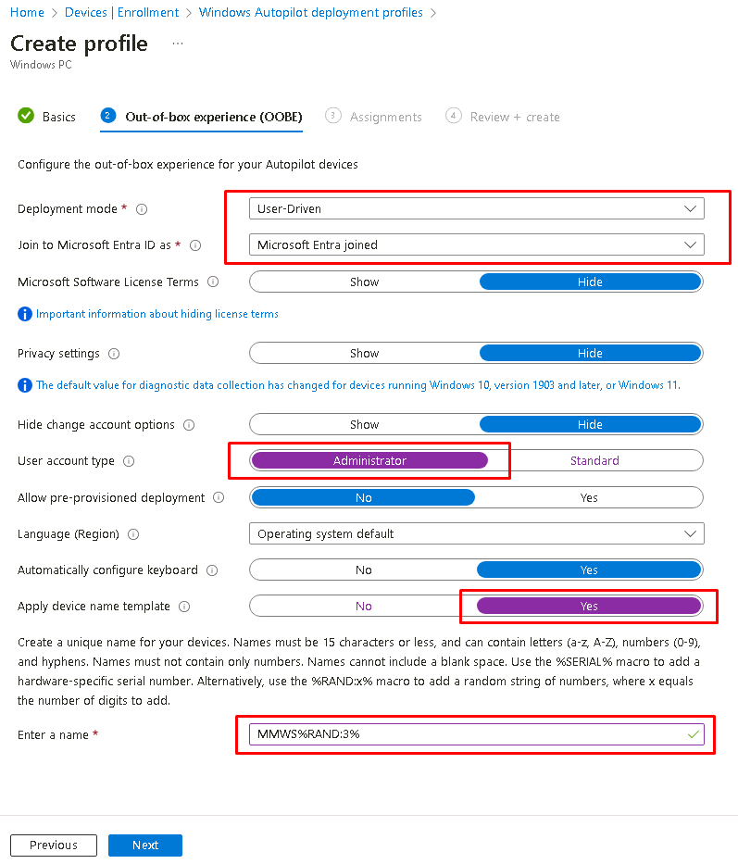
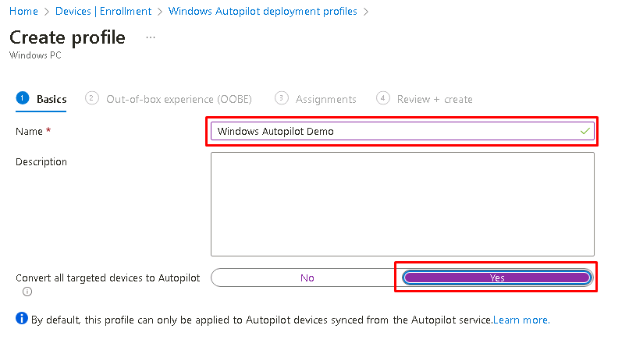
Exercise 2: Configure Deployment Profile
Create Profile for Windows PC

Slide 27
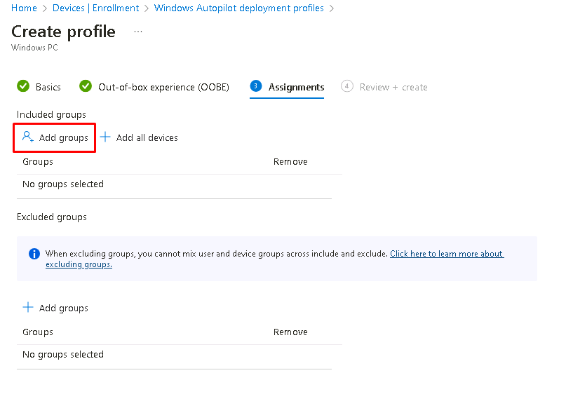
Exercise 2: Assign Deployment Profile
Assign to Enrollment profile Windows Autopilot Demo

Slide 28
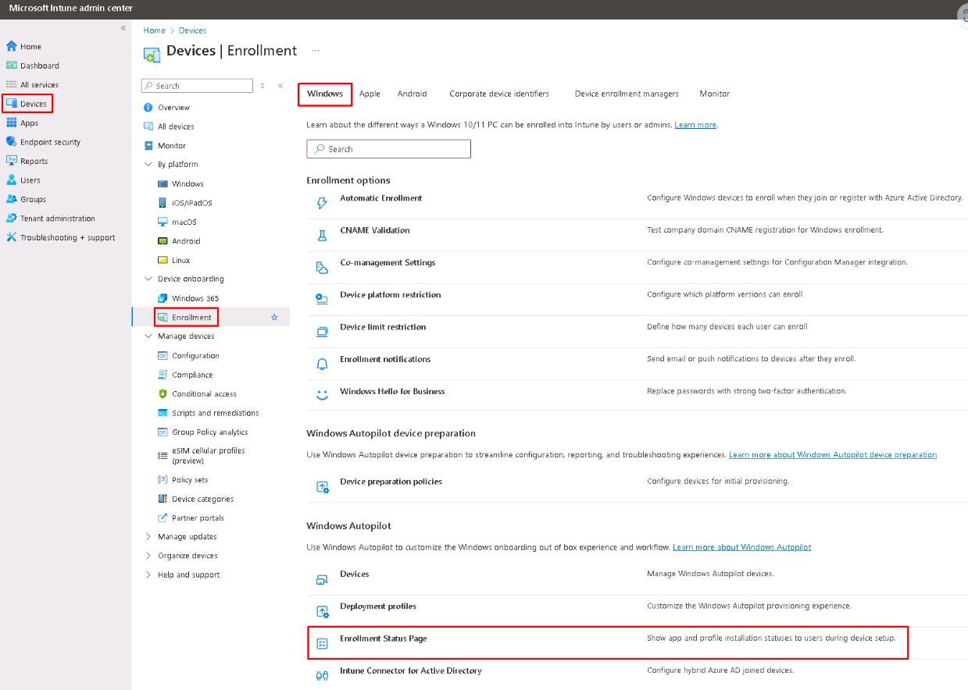
Exercise 3: Configure Enrollment Status Page
https://intune.microsoft.com

Slide 29
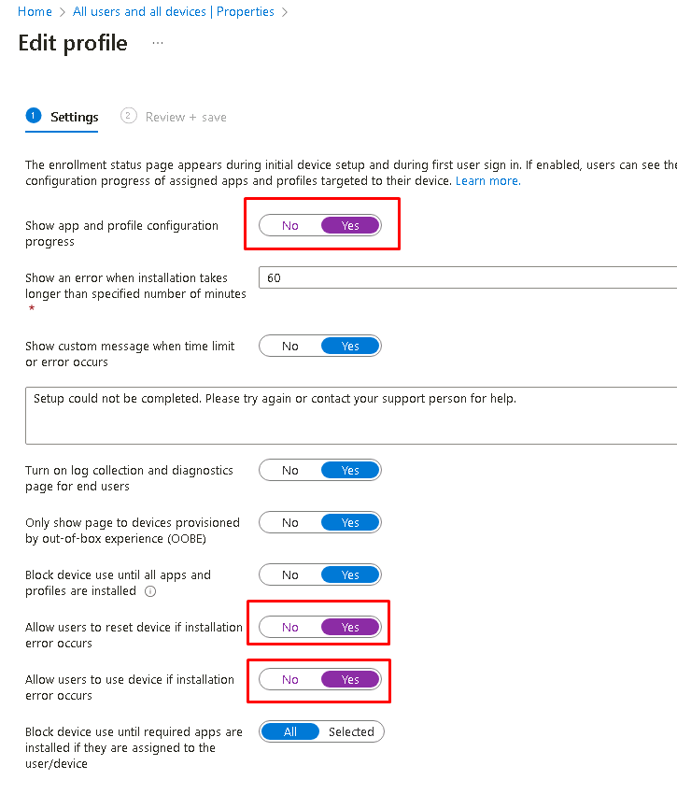
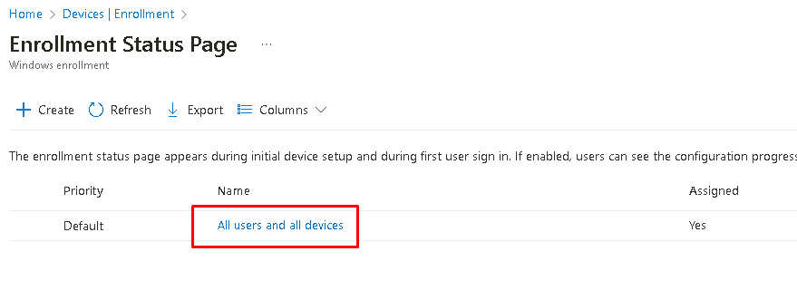
Exercise 3: Configure Enrollment Status Page
All users and all device - Edit
Configure the profile

Slide 30
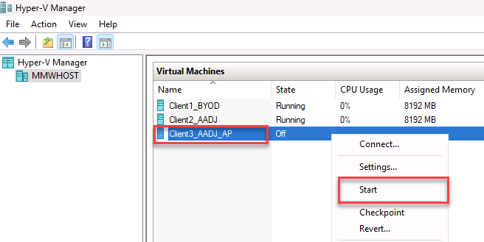
Exercise 4: Gather Hardware Information
Start and Connect to Virtual Machine CLIENT3_AADJ_AP

Slide 31
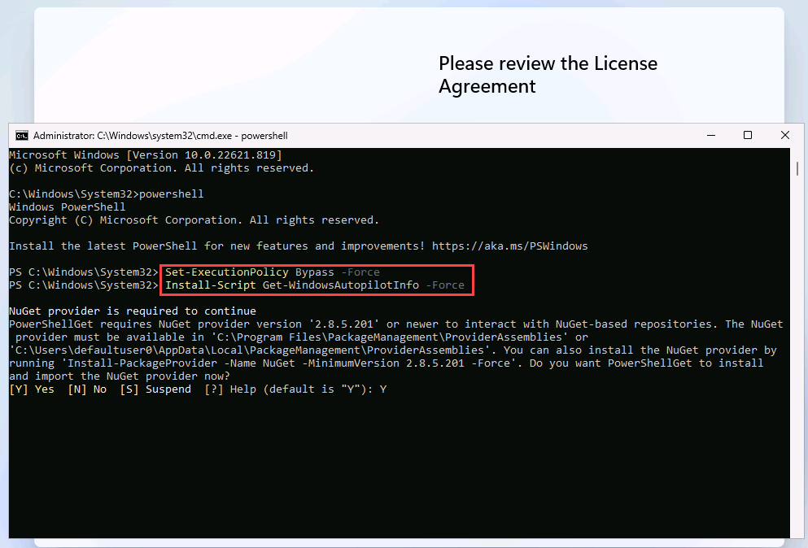
Exercise 4: Gather Hardware Information
SHIFT + F10
powershell
Set-ExecutionPolicy Bypass –Force
Install-Script Get-WindowsAutopilotInfo –Force
Answer “Y” to any prompts

Slide 32
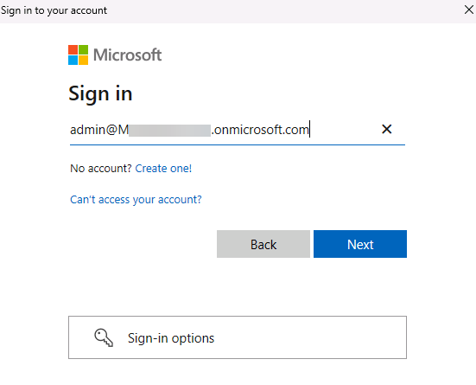
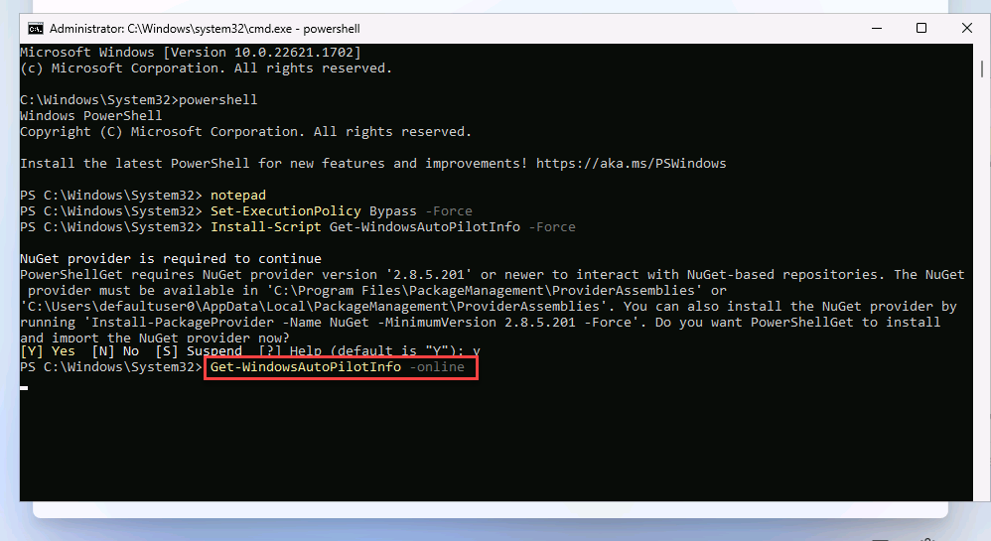
Exercise 4: Gather Hardware Information
Sign in with IN-Admin1

Slide 33
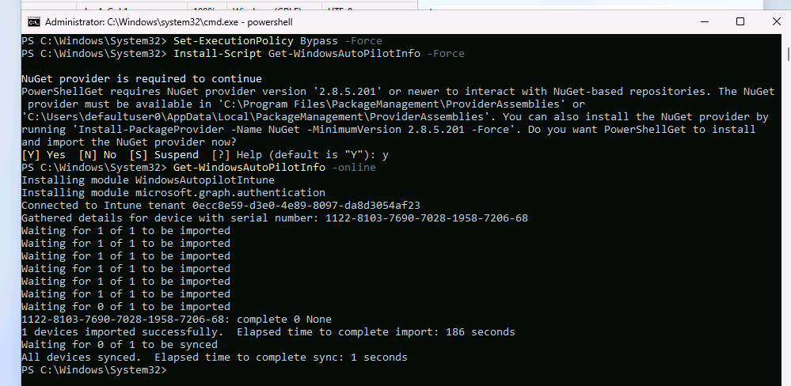
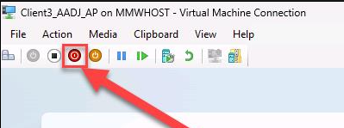
Exercise 4: Gather Hardware Information
Before turning off the device, we need to ensure that the device got imported successfully

Slide 34
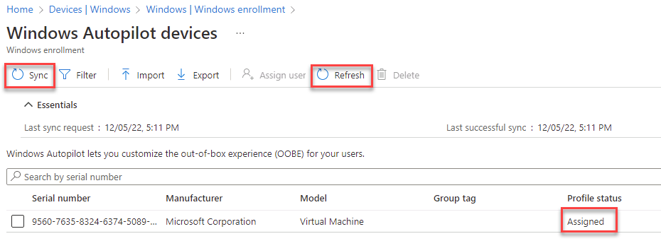
Exercise 5: Review the imported device

Slide 35
Module 3: Application Management

Slide 36

Lab 1: Create and deploy applications
Exercise 1: Create a Software Deployment Group
Exercise 2: Create and deploy the Company Portal app

Slide 37

Exercise 1: Create Software Deployment Group
https://intune.microsoft.com

Slide 38


Exercise 2: Deploy Company Portal App
https://intune.microsoft.com

Slide 39




Exercise 2: Deploy Company Portal App
https://intune.microsoft.com

Slide 40

Exercise 2: Sync Policies to speedup the installation
Go on the client to Settings > Accounts > Access work or school > Managed by [Company]

Slide 41

Lab 2: Using the Win32 App Converter
Exercise 1: Download the application converter and convert the application
Exercise 2: Create the application in Intune
Exercise 3: Install the application

Slide 42


Exercise 1: Download the application converter

Slide 43

Exercise 1: Download Remote Help

Slide 44


Exercise 1: Run the application converter
The tool will create the file C:\intune\output\Remotehelpinstaller.intunewin.

Slide 45


Exercise 2: Create the application in Intune

Slide 46


Exercise 2: Create the application in Intune

Slide 47

Exercise 2: Create the application in Intune

Slide 48

Exercise 2: Create the application in Intune

Slide 49


Exercise 2: Create the application in Intune

Slide 50

Exercise 2: Create the application in Intune

Slide 51




Exercise 3: Install the application

Slide 52
Module 4: Setting Catalog vs Group Policies

Slide 53

Lab 1: Device Configuration
Exercise 1: Review Group Policy Analytics
Exercise 2: Import third party ADMX

Slide 54

Exercise 1: Create IN-ConfigProfiles Security Group
https://intune.microsoft.com

Slide 55


Exercise 1: Upload Group policy xml file
https://intune.microsoft.com

Slide 56

Exercise 1: Check and Migrate your desired policies
https://intune.microsoft.com

Slide 57



Exercise 1: Check and Migrate your desired policies
https://intune.microsoft.com

Slide 58

Exercise 2: Import 3rd party ADMX
https://intune.microsoft.com

Slide 59


Exercise 2: Import 3rd party ADMX
https://intune.microsoft.com

Slide 60




Exercise 2: Use imported template to generate settings
https://intune.microsoft.com

Slide 61
Appendix: Demystifying Cloud Native Myths

Slide 62

Myth 1: I cannot access my onprem file shares from a cloud native device
This statement is wrong
If you are using Synced Identities from Active Directory – those users have a partial Kerberos ticket, which will allow you to authenticate against onprem resources.
What can I use:
PowerShell
Imported ADMX files Intune Drive Mappings | Managing Drive letters with an ADMX
Community tools Intune Drive Mapping Generator

Slide 63

Myth 2: I cannot assign my printers to Cloud Native Devices.
Universal Print – Cloud Based Print Solution
How to install Printer Drivers and Printers from Intune using Win32 apps and PowerShell - MSEndpointMgr

Slide 64

Myth 3: Can I access onprem applications using Kerberos Authentication?
Add an on-premises application for remote access through application proxy in Microsoft Entra ID. - Microsoft Entra ID | Microsoft Learn
Kerberos Authentication will also work

Slide 65
Thank you!
We appreciate your time with us.
For more info: ken.goossens@microsoft.com or/and hdhaliwal@microsoft.com
Stop by the Expert Meet-up in the Hub on Level 3 to get your questions answered
Your feedback is important! Visit https://aka.ms/MicrosoftIgniteEvals to complete your session evaluations

Slide 66
Microsoft Logo

